Slide 1
Introduction to Computer Networks
Layer 3 and the Internet Protocol (IP)

Slide 2
Outline
IP: The Internet Protocol
  Service characteristics
  The IP Datagram format
  IP addresses
  Classless Interdomain Routing (CIDR)
  An aside: Turning names into addresses (DNS)
  Forwarding IP Datagrams

Slide 3
The Internet Protocol (IP)
Protocol Stack
App
Transport
TCP / UDP
Data
Hdr
TCP Segment
Network
IP
Data
Hdr
IP Datagram
Link

Slide 4
The Internet Protocol (IP)
Characteristics of IP
  CONNECTIONLESS: mis-sequencing
  UNRELIABLE: may drop packets…
  BEST EFFORT: … but only if necessary
  DATAGRAM: individually routed
Source
D
H
Destination
A
B
R2
D
H
R1
R3
Architecture
Links
Topology
R4
Transparent

Slide 5
The IP Datagram
vers
HLen
TOS
Total Length
Offset within original packet
ID
Flags
FRAG Offset
Hop count
TTL
Protocol
checksum
SRC IP Address
<=64 KBytes
DST IP Address
(OPTIONS)
(PAD)

Slide 6
Fragmentation
Problem: A router may receive a packet larger than the maximum transmission unit (MTU) of the outgoing link.
Source
Destination
A
B
Ethernet
MTU=1500 bytes
MTU=1500 bytes
MTU<1500 bytes
R1
R2
Solution: R1 fragments the IP datagram into mutiple, self-contained datagrams.
Data
HDR (ID=x)
Offset=0
More Frag=1
Offset>0
More Frag=0
Data
HDR (ID=x)
Data
HDR (ID=x)
Data
HDR (ID=x)

Slide 7
Fragmentation
Fragments are re-assembled by the destination host; not by intermediate routers.
To avoid fragmentation, hosts commonly use path MTU discovery to find the smallest MTU along the path.
Path MTU discovery involves sending various size datagrams until they do not require fragmentation along the path.
Most links use MTU>=1500bytes today.
Try:
traceroute –f berkeley.edu 1500 and
traceroute –f berkeley.edu 1501
(DF=1 set in IP header; routers send “ICMP” error message, which is shown as “!F”).
Bonus: Can you find a destination for which the path MTU < 1500 bytes?

Slide 8
IP Addresses
IP (Version 4) addresses are 32 bits long
Every interface has a unique IP address:
  A computer might have two or more IP addresses
  A router has many IP addresses
IP addresses are hierarchical
  They contain a network ID and a host ID
  E.g. Stanford addresses start with: 171.64…
IP addresses are assigned statically or dynamically (e.g. DHCP)
IP (Version 6) addresses are 128 bits long

Slide 9
IP Addresses
Originally there were 5 classes:
1
7
24
CLASS “A”
0
Net ID
Host-ID
2
14
16
CLASS “B”
10
Net ID
Host-ID
3
21
8
CLASS “C”
110
Net ID
Host-ID
4
28
CLASS “D”
1110
Multicast Group ID
5
27
CLASS “E”
11110
Reserved
A
B
C
D
0
2³²-1

Slide 10
IP Addresses
Examples
Class “A” address: www.mit.edu
  18.181.0.31
  (18<128 => Class A)
Class “B” address: mekong.stanford.edu
  171.64.74.155
  (128<171<128+64 => Class B)

Slide 11
IP Addressing
Problem:
Address classes were too “rigid”. For most organizations, Class C were too small and Class B too big. Led to inefficient use of address space, and a shortage of addresses.
Organizations with internal routers needed to have a separate (Class C) network ID for each link.
And then every other router in the Internet had to know about every network ID in every organization, which led to large address tables.
Small organizations wanted Class B in case they grew to more than 255 hosts. But there were only about 16,000 Class B network IDs.

Slide 12
IP Addressing
Two solutions were introduced:
Subnetting within an organization to subdivide the organization’s network ID.
Classless Interdomain Routing (CIDR) in the Internet backbone was introduced in 1993 to provide more efficient and flexible use of IP address space.
CIDR is also known as “supernetting” because subnetting and CIDR are basically the same idea.

Slide 13
Subnetting
CLASS “B”
e.g. Company
2
14
16
10
Net ID
Host-ID
2
14
16
2
14
16
e.g. Site
0000
Host-ID
1111
Host-ID
10
Net ID
10
Net ID
Subnet ID (20)
Subnet
Host ID (12)
Subnet ID (20)
Subnet
Host ID (12)
2
14
16
2
14
16
e.g. Dept
Host-ID
10
Net ID
1111011011
Host-ID
10
Net ID
000000
Subnet ID (22)
Subnet
Host ID (10)
Subnet ID (26)
Subnet
Host ID (6)

Slide 14
Subnetting
Subnetting is a form of hierarchical routing.
Subnets are usually represented via an address plus a subnet mask or “netmask”.
e.g.
nickm@elaine17.Stanford.EDU > ifconfig hme0
hme0: flags=863<UP,BROADCAST,NOTRAILERS,RUNNING,MULTICAST> mtu 1500
inet 171.64.15.82 netmask ffffff00 broadcast 171.64.15.255
Netmask ffffff00: the first 24 bits are the subnet ID, and the last 8 bits are the host ID.
Can also be represented by a “prefix + length”, e.g. 171.64.15.0/24, or just 171.64.15/24.

Slide 15
Example of subnetting at Stanford
hpr1-rtr
To: cenic.net
171.64.1.131
171.64.74.0/24
171.64.1.132/30
171.64.1.133
171.64.1.161
171.64.1.178
171.64.74.1
Stanford Class B
Address
bbr2-rtr
Gates-rtr
171.64.1.160/27
171.64.74.58
171.64.0.0/16
AS 32
yuba
171.64.1.152
border2-rtr
171.64.1.144/28
To: cogentco.com
171.64.1.148
As of Jan 2006

Slide 16
Classless Interdomain Routing (CIDR)
Addressing
The IP address space is broken into line segments.
Each line segment is described by a prefix.
A prefix is of the form x/y where x indicates the prefix of all addresses in the line segment, and y indicates the length of the segment.
e.g. The prefix 128.9/16 represents the line segment containing addresses in the range: 128.9.0.0 … 128.9.255.255.
128.9.0.0
142.12/19
65/8
128.9/16
0
2³²-1
2¹⁶
128.9.16.14

Slide 17
Classless Interdomain Routing (CIDR)
Addressing
128.9.19/24
128.9.25/24
128.9.16/20
128.9.176/20
128.9/16
0
2³²-1
128.9.16.14
Most specific route = “longest matching prefix”

Slide 18
Classless Interdomain Routing (CIDR)
Addressing
Prefix aggregation:
If a service provider serves two organizations with prefixes, it can (sometimes) aggregate them to form a shorter prefix. Other routers can refer to this shorter prefix, and so reduce the size of their address table.
E.g. ISP serves 128.9.14.0/24 and 128.9.15.0/24, it can tell other routers to send it all packets belonging to the prefix 128.9.14.0/23.
ISP Choice:
In principle, an organization can keep its prefix if it changes service providers.

Slide 19
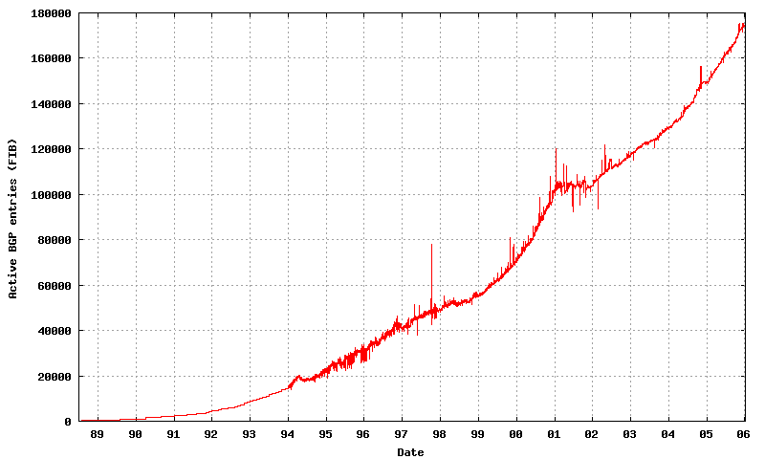
Size of the Routing Table at the core of the Internet
Source: http://www.cidr-report.org/

Slide 20
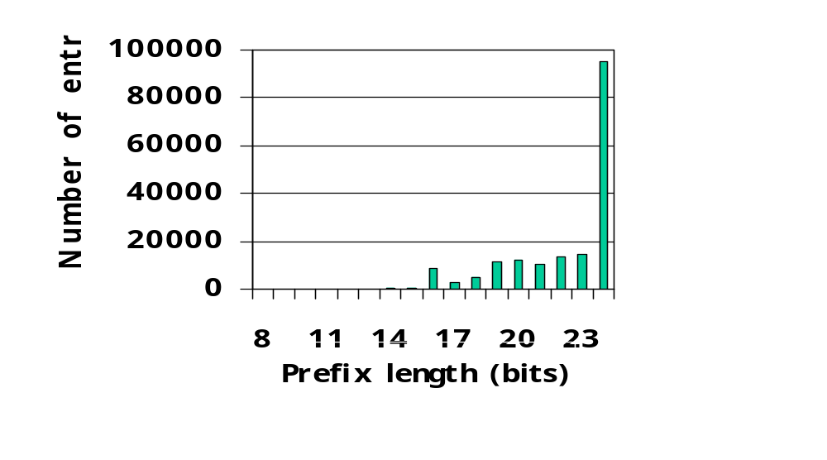
Prefix Length Distribution
Source: Geoff Huston, Jan 2006

Slide 21
Mapping Computer Names to IP addresses
The Domain Naming System (DNS)
Names are hierarchical and belong to a domain:
  e.g. elaine17.stanford.edu
  Common domain names: .com, .edu, .gov, .org, .net, .uk (or other country-specific domain).
  Top-level names are assigned by the Internet Corporation for Assigned Names and Numbers (ICANN).
  A unique name is assigned to each organization.
DNS Client-Server Model
  DNS maintains a hierarchical, distributed database of names.
  Servers are arranged in a hierarchy.
  Each domain has a “root” server.
  An application needing an IP address is a DNS client.

Slide 22
Mapping Computer Names to IP addresses
The Domain Naming System (DNS)
A DNS Query
  Client asks local server.
  If local server does not have address, it asks the root server of the requested domain.
  Addresses are cached in case they are requested again.
  E.g. www.eecs.berkeley.edu
.stanford.edu
“What is the IP address of
www.eecs.berkeley.edu?”
e.g. gethostbyname()
.edu
Client
application
.berkeley.edu
.eecs.berkeley.edu
Example: On elaine machines, try “host www.mit.edu”

Slide 23
An example of names and addresses
Mapping the path between two hosts
nickm@yuba.Stanford.EDU > host yuba
  yuba.Stanford.EDU. has address 171.64.74.58
nickm@yuba.Stanford.EDU > traceroute www.mit.edu
traceroute to www.mit.edu (18.7.22.83), 30 hops max, 38 byte packets
1 Gates-rtr (171.64.74.1) 0.539 ms 0.381 ms 0.388 ms
2 bbr2-rtr (171.64.1.161) 0.373 ms 0.366 ms 0.368 ms
3 hpr1-rtr (171.64.1.131) 0.832 ms 0.992 ms 0.902 ms
4 hpr-svl-hpr--stan-ge.cenic.net (137.164.27.161) 1.596 ms 0.988 ms 1.363 ms
5 lax-hpr--svl-hpr-10ge.cenic.net (137.164.25.12) 9.065 ms 8.895 ms 8.948 ms
6 abilene-LA--hpr-lax-gsr1-10ge.cenic.net (137.164.25.3) 8.884 ms 8.816 ms 9.080 ms
7 snvang-losang.abilene.ucaid.edu (198.32.8.95) 16.414 ms 16.562 ms 16.763ms
8 dnvrng-snvang.abilene.ucaid.edu (198.32.8.2) 42.058 ms 41.515 ms 41.068 ms
9 kscyng-dnvrng.abilene.ucaid.edu (198.32.8.14) 52.901 ms 56.792 ms 51.923ms
10 iplsng-kscyng.abilene.ucaid.edu (198.32.8.80) 71.886 ms 61.674 ms 64.450ms
11 chinng-iplsng.abilene.ucaid.edu (198.32.8.76) 64.987 ms 64.824 ms 64.839ms
12 nycmng-chinng.abilene.ucaid.edu (198.32.8.83) 85.108 ms 84.846 ms 85.009ms
13 nox230gw1-PO-9-1-NoX-NOX.nox.org (192.5.89.9) 90.206 ms 90.227 ms 90.044ms
14 nox230gw1-PEER-NoX-MIT-192-5-89-90.nox.org (192.5.89.90) 89.922 ms 90.332ms 90.242 ms
15 B24-RTR-3-BACKBONE.MIT.EDU (18.168.0.26) 90.193 ms 90.373 ms 90.374 ms
16 WWW.MIT.EDU (18.7.22.83) 90.762 ms 90.996 ms 90.271 ms

Slide 24
Example
Mapping the path between two hosts
nickm@yuba.Stanford.EDU > host bbr2-rtr.stanford.edu | sort -n
  bbr2-rtr.Stanford.EDU has address 128.12.1.49
  bbr2-rtr.Stanford.EDU has address 171.64.0.126
  bbr2-rtr.Stanford.EDU has address 171.64.1.133
  bbr2-rtr.Stanford.EDU has address 171.64.1.152
  bbr2-rtr.Stanford.EDU has address 171.64.1.161
  bbr2-rtr.Stanford.EDU has address 171.64.1.242
  bbr2-rtr.Stanford.EDU has address 171.64.1.26
  bbr2-rtr.Stanford.EDU has address 171.64.1.9
  bbr2-rtr.Stanford.EDU has address 171.64.1.97
  bbr2-rtr.Stanford.EDU has address 171.64.3.242
  bbr2-rtr.Stanford.EDU has address 171.64.7.60
  bbr2-rtr.Stanford.EDU has address 171.66.1.249
  bbr2-rtr.Stanford.EDU has address 171.66.16.1
  bbr2-rtr.Stanford.EDU has address 171.67.1.193
  bbr2-rtr.Stanford.EDU has address 171.67.20.1
  bbr2-rtr.Stanford.EDU has address 171.67.254.242
  bbr2-rtr.Stanford.EDU has address 171.67.255.126
  bbr2-rtr.Stanford.EDU has address 172.24.1.9
  bbr2-rtr.Stanford.EDU has address 172.27.20.1
  bbr2-rtr.Stanford.EDU has address 192.168.2.129
  bbr2-rtr.Stanford.EDU has address 192.168.7.154

Slide 25
Example
Mapping the path between two hosts
hpr1-rtr
To: cenic.net
171.64.1.131
171.64.74.0/24
171.64.1.132/30
171.64.1.133
171.64.1.161
171.64.1.178
171.64.74.1
Stanford Class B
Address
bbr2-rtr
Gates-rtr
171.64.1.160/27
171.64.74.58
171.64.0.0/16
AS 32
yuba
171.64.1.152
border2-rtr
171.64.1.144/28
To: cogentco.com
171.64.1.148
As of Jan 2006

Slide 26
An aside:
Error Reporting (ICMP) and traceroute
Internet Control Message Protocol:
  Used by a router/end-host to report some types of error:
  E.g. Destination Unreachable: packet can’t be forwarded to/towards its destination.
  E.g. Time Exceeded: TTL reached zero, or fragment didn’t arrive in time. Traceroute uses this error to its advantage.
  An ICMP message is an IP datagram, and is sent back to the source of the packet that caused the error.

Slide 27
How a Router Forwards Datagrams
128.17.20.1
e.g. 128.9.16.14 => Port 2
R2
Prefix
Next-hop
Port
65/8
128.17.16.1
3
R1
R3
1
128.9/16
128.17.14.1
2
2
3
128.9.16/20
128.17.14.1
2
128.9.19/24
128.17.10.1
7
128.9.25/24
128.17.14.1
2
R4
128.9.176/20
128.17.20.1
1
142.12/19
128.17.16.1
3
128.17.16.1
Forwarding/routing table

Slide 28
How a Router Forwards Datagrams
Every datagram contains a destination address.
The router determines the prefix to which the address belongs, and routes it to the“Network ID” that uniquely identifies a physical network.
All hosts and routers sharing a Network ID share same physical network.

Slide 29
Forwarding Datagrams
Is the datagram for a host on a directly attached network?
If no, consult forwarding table to find next-hop.

Slide 30
Inside a router
Link 1, ingress
Choose
Egress
Link 1, egress
Link 2, ingress
Choose
Egress
Link 2, egress
Link 3, ingress
Choose
Egress
Link 3, egress
Link 4, ingress
Choose
Egress
Link 4, egress

Slide 31
Inside a router
Forwarding
Table
Link 1, ingress
Forwarding
Decision
Link 1, egress
Link 2, ingress
Choose
Egress
Link 2, egress
Link 3, ingress
Choose
Egress
Link 3, egress
Link 4, ingress
Choose
Egress
Link 4, egress

Slide 32
Forwarding in an IP Router
Lookup packet DA in forwarding table.
  If known, forward to correct port.
  If unknown, drop packet.
Decrement TTL, update header Checksum.
Forward packet to outgoing interface.
Transmit packet onto link.
Question: How is the address looked up in a real router?

Slide 33

Making a Forwarding Decision
Class-based addressing
IP Address Space
Class A
Class B
Class C
D
Class A
Class B
Routing Table:
212.17.9.4
Exact
Class C
Match
212.17.9.0
212.17.9.0
Port 4
Exact Match: There are many well-known ways to find an exact match in a table.

Slide 34
Direct Lookup
IP Address
Next-hop, Port
Memory
Data
Address
Problem: With 2³² addresses, the memory would require 4 billion entries.

Slide 35
Associative Lookups
“Contents addressable memory” (CAM)
Associative
Memory or CAM
Advantages:
Simple
Disadvantages
Slow
High Power
Small
Expensive
Network
Address
Port
Number
Port
Number
Search
Data
Hit?
32
Search data is compared with every entry in parallel

Slide 36
Hashed Lookups
Associated
Data
Search
Data
{
Hashing
Function
32
16
Address
Memory
Data
Hit?
Address
log₂N

Slide 37
Lookups Using Hashing
An example
Memory
#1
#2
#3
#4
Search
Data
Associated
Data
16
#1
#2
Hashing Function
Hit?
32
#1
#2
#3
Linked list of entries
with same hash key.

Slide 38
Lookups Using Hashing
Advantages:
Simple
Expected lookup time can be small
Disadvantages
Non-deterministic lookup time
Inefficient use of memory

Slide 39
Trees and Tries
Binary Search Tree:
Binary Search Trie:
(“reTRIEval”)
<
>
0
1
log₂N
<
>
<
>
0
1
0
1
N entries
010
111
Requires 32 memory references, regardless of number of addresses.

Slide 40
Search Tries
Multiway tries reduce the number of memory references
16-ary Search Trie
0000, ptr
1111, ptr
0000, 0
1111, ptr
0000, 0
1111, ptr
000011110000
111111111111
Question: Why not just keep increasing the degree of the trie?

Slide 41
Classless Addressing
CIDR
128.9.19/24
128.9.25/24
128.9.16/20
128.9.176/20
128.9/16
0
2³²-1
128.9.16.14
Most specific route = “longest matching prefix”
Question: How can we look up addresses if they are not an exact match?

Slide 42
Ternary CAMs
Associative Memory
Value
Mask
Port
10.1.1.32
255.255.255.255
1
10.1.1.0
255.255.255.0
2
Port
10.1.3.0
255.255.255.0
3
10.1.0.0
255.255.0.0
4
10.0.0.0
255.0.0.0
4
Priority Encoder
Note: Most specific routes appear closest to top of table

Slide 43
Longest prefix matches using Binary Tries
0
1
Example Prefixes:
a) 00001
b) 00010
g
c) 00011
d) 001
i
e) 0101
d
f
f) 011
g) 10
h
h) 1010
e
j
i) 111
a
b
c
j) 111100
k) 11110001
k

Slide 44
Lookup Performance Required
Line
Line Rate
Pkt­size=40B
Pkt­size=240B
T1
1.5Mbps
4.68
Kpps
0.78
Kpps
OC3
155Mbps
480
Kpps
80
Kpps
OC12
622Mbps
1.94
Mpps
323
Kpps
OC48
2.5Gbps
7.81
Mpps
1.3
Mpps
OC192
10
Gbps
31.25
Mpps
5.21
Mpps

Slide 45
Discussion
Why was the Internet Protocol designed this way?
  Why connectionless, datagram, best-effort?
  Why not automatic retransmissions?
  Why fragmentation in the network?
Must the Internet address be hierarchical?
What address does a mobile host have?
Are there other ways to design networks?

